Slide 1
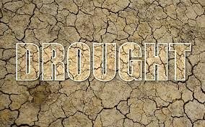
Report about:

Slide 2
The questions:
1/What’s drought ?
A1/It’s long period of low rainfall 70%
A2/dangerous natural disaster hit the hot regions 30%
2/Can drought affect the water level in wells?
YES 60% NO 40%
3/ does a drought go away when it rains?
YES 90% NO 10%
4/What causes droughts?
A1/Lack of rainfall 10%
A2/ deforestation 20%
A3/Global warming 70%

Slide 3
5/ When does a drought begin?
A1/When rain doesn’t fall for longtime 65%
A2/Soils begin to decrease 35%
6/Does a shortage of rain mean that a drought will occur?
NO 25% YES 75%
7/What’s the Efftects of Droughts?
A1/Drying out of water bodies 20% A2/Reduction in soil quality 20% A3/Migration and even death of Animal 60%
8/What the solution to avoid this disaster?
A1/Stop wasting water 85%
A2/Forestation 15%

Slide 4
²

Slide 5
Report:
introduction:
First of all;we make this report because our town(KANTARA) Threatened by drought especially last years in order to educate People
What’s drought?
70%of our informants said that the drought was a long period of law rainfall and 30%of students thought that drought meant dangerous natural disaster hit the hot regions
does a drought go away when it rains?
The majority of pupils said ‘yes’; However the truth is the drought doesn’t go away because the most of the rain that falls will be quickly evaporated or used by plants

Slide 6
4/What causes droughts?
70% of our informants said that Global warming was the fundamental cause, in other side 20% of persons believed that the cause was the deforestation also just10%of them said that the lack of rainfall was considered like cause
5/ When does a drought begin?
Observation: The beginning of a drought is difficult to determine. Several weeks, months, or even years may pass before people know that a drought is occurring like In California, the drought extended from 1928 to 1937!!!
65% of them sugested that the begining of disaster appeared when rain doesn’t fall for longtime but 35% of informants thought that the Soils begin to decrease is the first mark of drought

Slide 7
7/What’s the Efftects of Droughts?
The drought has many effects SO 60% answred that the Migration and even death of Animal was the worst impact but the rest of students supposed that the Drying out of water bodies and Reduction in soil quality
Imagine that:
you turn the tap on and no water flows, and the water authority officials tell you that water will not flow for weeks or months because there is a drought.
people cannot go to school and work because there is the outbreak of diseases as a result of lack of water for sanitation purposes.
So you see, there is a myriad of problems that droughts can bring.

Slide 8
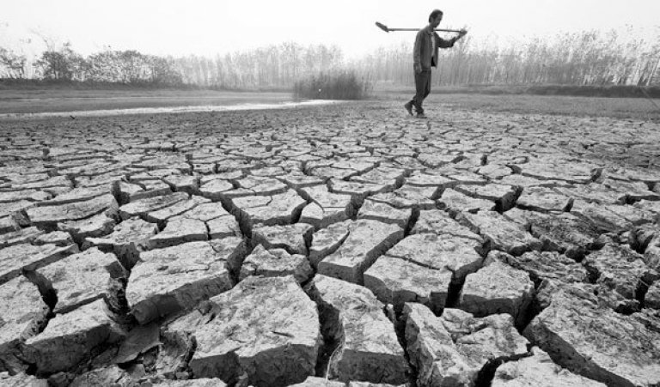
8/What the solution to avoid this disaster?
Finally,85% of our colleagues agreed that the preserving water was the effictive way to save our town from drought and 15% of them stated that the forestion could kept the fair-weather ,the rainfall over the year
The worst drought in history:
The worst famine caused by drought
was in northern China in 1876-79,
when between 9 and 13 million people
died after the rains failed for three
consecutive years.
At around the same time (1876-78)
, 5 million Indians died when
the monsoon failed in successive years.

Slide 9
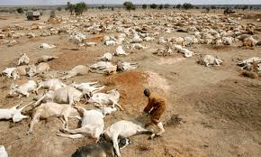
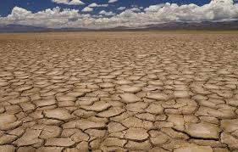
2/In 1981 to 1984 Africa suffered from severe drought in twenty nations. As rivers and lakes dried up, crops and livestock died resulting in up to 20,000 people starving to death each month. Other nations saw the need and came to Africa’s aid. However, by the end of the crisis, over a million people had succumbed to death.

Slide 10
Created by:
Mohammed tifrani
Charaf tawlilit
Mahdi chili
Mohammed zadem
Baloli nasridine

