Slide 1
Nobel Peace Prize Project
Aymen Bouzidi
Hadjab Safouane
Hadjab Othmane
Produced by:

Slide 2
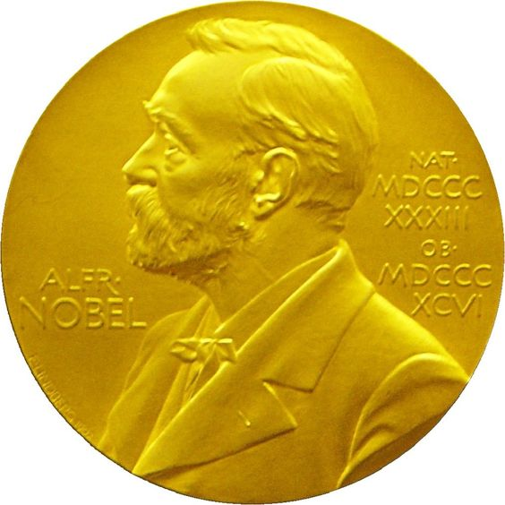
Short Background :
The Nobel Peace Prize is one of the five Nobel Prizes created by the Swedish inventor Alfred Nobel. It awarded to those who make efforts to preverve peace around the whole world and who want to use his fortune to serve the humanity. The first prize was given to Henry Dunant in 1901. The winners of the prize are chosen bu The Nobel institute in Olso on the 10th December of each year . The Chirman Norwegian Nobel Committee presents the prize in the presence of the king of Norway. The Nobel laureate recives a diploma, a medal and a doucement confirming the prize amout and more than 1.4 million US dollars .

Slide 3
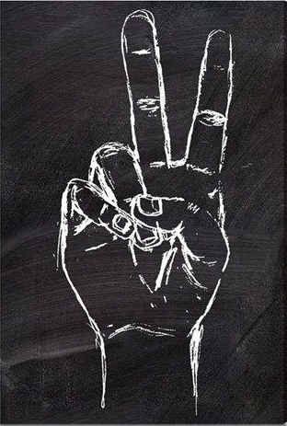
List of Nobel peace
prize winner of
Last decade :

Slide 4
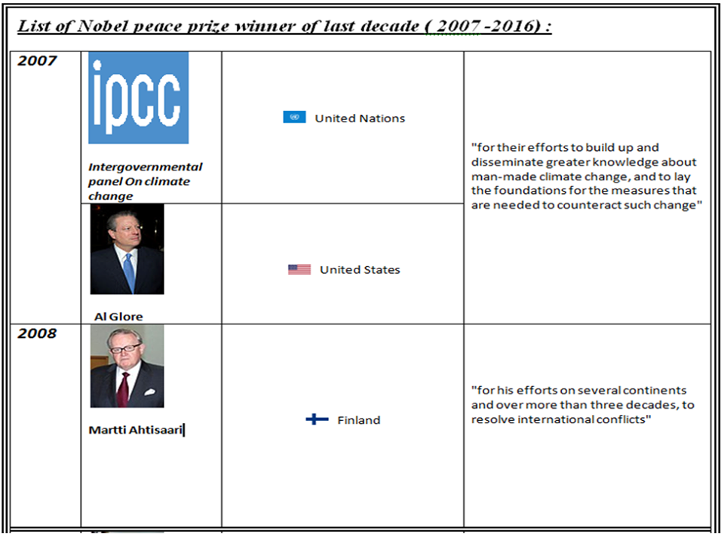

Slide 5
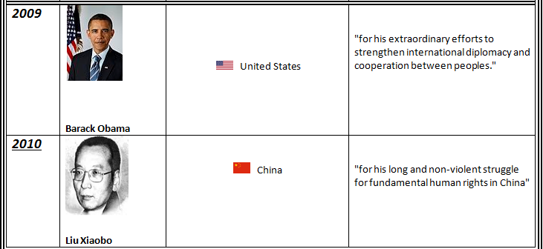

Slide 6
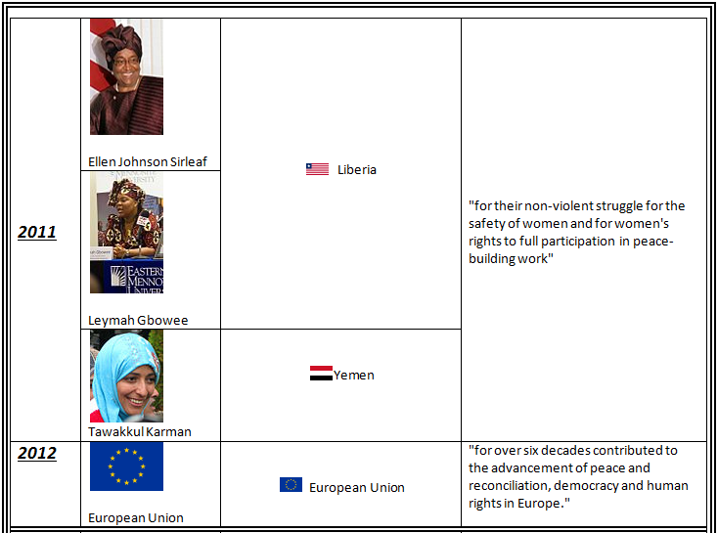

Slide 7
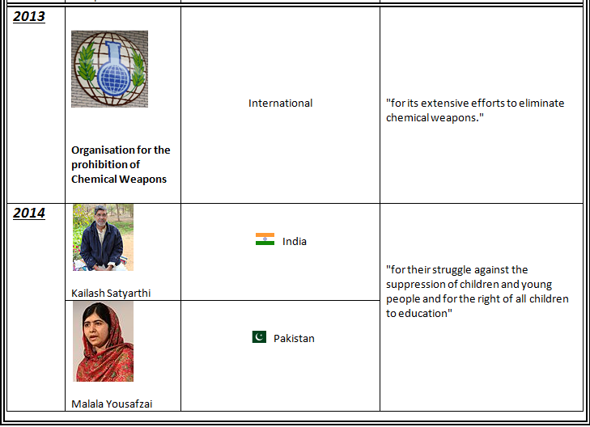

Slide 8
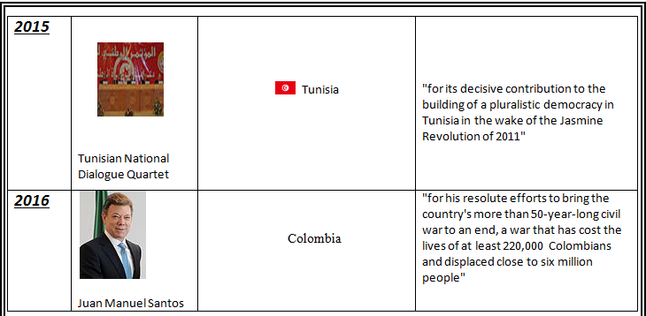

Slide 9

The Nobel peace prize winners's
Biographies :

Slide 10
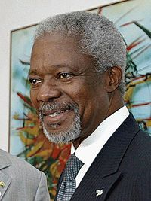
Kofi Annan

Slide 11
He was born into a family of traditional chiefs of the Fante tribe in Ghana, Kofi Annan rose to become Secretary General of the United Nations, winning the Nobel Peace Prize in 2001. He grew up in Ghana where he became known as a student leader. He gained a scholarship to study in the US. He also later studied in Geneva before returning to the US to study management at MIT.
For most of his life he has worked in the United Nations rising from the lower ranks to become one of the few insiders to be awarded the top job of Secretary General. He served as Secretary General for two terms from 1997 to 2007. He began working for the World Health Organisation WHO in Geneva in 1962 and later served in the UN high commission for Refugees. Kofi Annan held a series of high profile positions from human resource management to peacekeeping (1992-1996)

Slide 12
Kofi Annan was widely liked by both fellow UN workers and even critics of the United Nations. For example, Mohamed Sacribey, the Bosnian Ambassador to the UN was very critical of the United Nations involvement in Bosnia. But, he exempted Kofi Annan. When asked why he replied simply: “Because he is honest”
He is known for his ability to get the best out of people but remains a man of principle and does not hesitate to express his convictions. His popularity with UN staff is partly because of his wish to:“put the individual human being at the centre of everything the United Nations does,” He is also known for his stoic calm amidst great uncertainty. He yogic detachment and inner peace are well suited to his task of international diplomacy. “The World is not ours to keep. We hold it in trust for future generations.”
Kofi Annan is married to Nane Annan from Sweden. She is a lawyer and painter and has been a strong supporter of the United Nations. They have had three children.

Slide 13
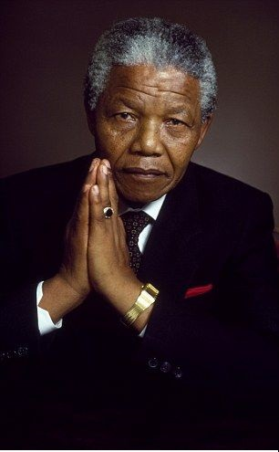
Nelson Mandela

Slide 14
Nelson was born on july 18, 1918 in Untata, South africa . He was educated at the University of Witwatersrand and qualified in law in 1942. hE joined the African National Congress( ANC) in 1944and in 1949 becam one of that black-liberation group's leaders, he helped in the organization of militant resistance against the apartheid poilicies of the ruling National Party which segregated between the Blacks and the whites.
In 1963 the police discovered quantities of arms and equipments at the headquarters of the ANC's military wing. Mandela had been the founder of th organisation and admitted the truth of the charges theat were made against him. oN june11,1964, he was sentenced to life prison.

Slide 15
Mandela retained wide support among south africa's black population, and his imprisonment became a cause celebre among the international community that attacked the apartheid. He was realesed from prison on February11, 1990 . In 1993 Mandela was awarded the Nobel Peace Prize for his efforts to end racism and to call for a peaceful transition to non-racial democracy in South Africa
Quote:
« No one is born hating another person because of the color of his skin, or his background, or his religion. People must learn to hate, and if that can learn to hate, they can be taught to love, for love comes more naturally to the human heart than its opposite ».

Slide 16

:
Algerians Noble peace
prize nominees :

Slide 17
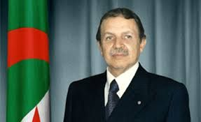
Abdelaziz bouteflika

Slide 18
He was born on march 2nd, 1937 in Oujda, Tlemcen. Abdelaziz became an officer in the National Liberation Army ( ALN )in 1956. After Algerian independence in 1962, Bouteflika was appointed minister for youth, sports, and tourism, and a year later he was made foreign minister. April 1999 , Bouteflika ran for the presidental elections and was selected officially with 74% of the .
Votes
His acheivments :
He is a national hero before and after his election as algeria's president , because he could bring back peace to our country.
He improved the relations with the other countries and he declared that the fate of Western Sahara is an Algerian and an international matter.

Slide 19
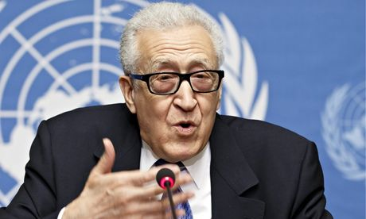
Lakhdar Ibrahimi

Slide 20
he is a veteran United Nations envoy and advisor. He was born on January 1st , in Algeria. Lakhdar was the United Nations special representative for afghanistan and iraq .Before his appointment in 2001 by Secretary-general Kofi Annan,he had served the UN as special represantative to Haiti and South africa . He retired from his
. duties at the end of 2005
His acheivments:
He was one of the fonders of the journal of Palestine Studies .called " la revue d'etude palestinienne "
He was also chairman of the panel of United Nations Peace operations, which produced the influntial Brahimi report..

Slide 21

Coclusion:
Coclusion:
Awarding Nobel peace prize to thes personlitieswill really encourage the efforts they do to keep peace.. Morever, it will contribute in making peace in algeria and middle east countries.
Finaly peace is not something you wish for, It’s something you make , Something you do, something you are , and something you give away.

