Slide 1
Abd El Hamid Akhrouf High school
Project n°1 :mAKE Peace
Class : 2AS2

Slide 2
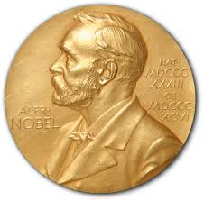
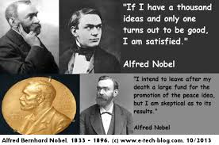
Nobel Peace Prize

Slide 3
Intoduction
When Alfred Nobel died on December 10th, 1896, it was discovered that he had left a will, dated November 27th, 1895, according to which most of his vast wealth was to be used for five prizes, including one for peace
According to Nobel's will, the Peace Prize shall be awarded to the person who
“shall have done the most or the best work for fraternity between nations, for the abolition or reduction of standing armies and for the holding and promotion of peace congresses ‘’
The Nobel Peace Prize is awarded by a committee of five persons who are chosen by the Norwegian Storting (Parliament of Norway), Oslo, Norway

Slide 4
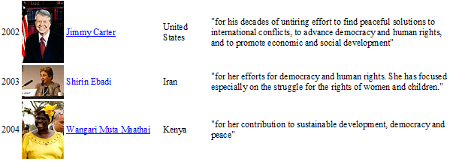
List of Nobel peace prize winner of he last decade

Slide 5
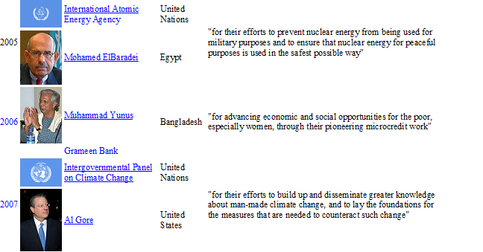

Slide 6
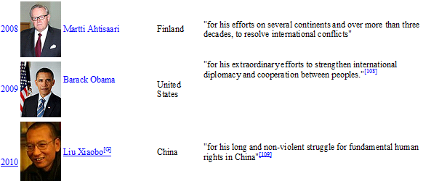

Slide 7
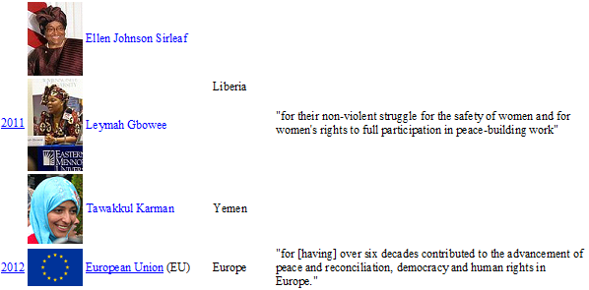

Slide 8
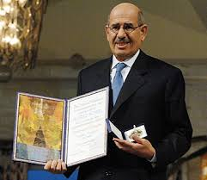
Mohammad el Baradei
He was born in Egypt , on June 17th,1942 . He studied in Cairo University and in Nez York law university where he got the PHD in 1974 . In 1964 he began career in Egyptian diplomatic service. In 1997 , he started his work as a director general of the IAEA (International Atomic Energy Agency).He is a peace man who made important efforts to prevent nuclear energy from being used for military purposes . So he won worthily the Nobel Peace Prize in 2005 .

Slide 9
Conclusion
Nobel Peace Prize is one of more importance prizes in the world , it awards for the best work for peace .
Finally peace remains something sacred does not need an award for his appreciation .

Slide 10
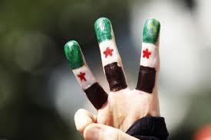
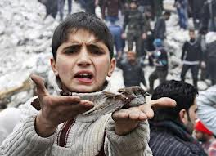
The war in Syria
How did it all start?
The trouble began in 2011 in the Syrian city of Deraa.
Locals took to the streets to protest after 15 schoolchildren had been arrested - and reportedly tortured - for writing anti-government graffiti on a wall.
The protests were peaceful to begin with, calling for the kids' release, democracy and greater freedom for people in the country.

Slide 11
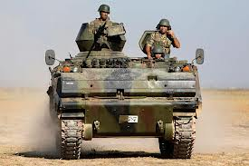
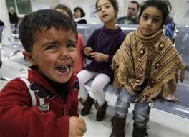
The government responded angrily, and on 18 March 2011, the army opened fire on protesters, killing four people. The following day, they shot at mourners at the victims' funerals, killing another person. People were shocked and angry at what had happened and soon the unrest had spread to other parts of the country.

Slide 12
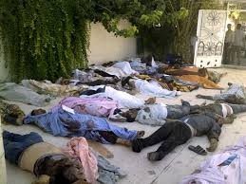
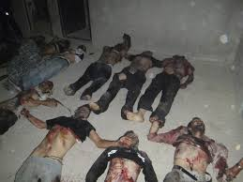
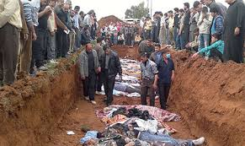
Since then, the United Nations estimates more than 100,000 people have died in the clashes between President Bashar al-Assad's government and rebel forces who want him out. The UN also says more than two million people have fled Syria to neighbouring countries, and over half of those refugees are children.

Slide 13
The End …

