Slide 1
The People's Democratic Republic of Algeria
ــبـســــــم الـــلـــه الـــرحـــمـــن الـــرحـــيـــم
Mustapha Ben Boulaid Secondary School
Third English Project:
Report On Scientific Experiments.
Class: 2nd year Experimental Science
School year: 2018-2019

Slide 2
Prepared By:
-Hamza Messadia
-Ayoub Guedri
Ali Salmi
Dhia Khachba
Mohaned Otmani
- Othmane Mansouria
-Djeddi Zakaria
Riad Zeidi
Yaakoub Selaimia

Slide 3
Plan Of The Project:
Intoduction
Problem
Definition of the Experiment.
Prevention and safety measures.
Steps Of the Experiment.
Materials used in the Experiment.
01
Hypothesis
02
Investigation and experimentation
03
Observation
04
Conclusion

Slide 4
Intoduction
Laboratory workers, chemists, even students and professors of scientific materials often suffer from problems because they sometimes find a chemical mixture that has lost its labels and become without information such as concentration, purity, amount of dissolved material, etc..., which makes these chemical mixtures unsuitable.

Slide 5
Problem:
How can I know the molar concentration of a solution?

Slide 6
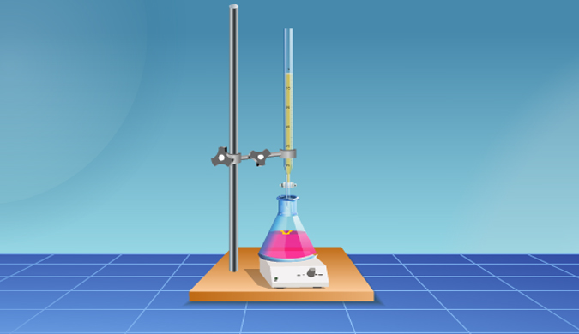
Hypothesis:
The process of titration will be used to determine the concentration of a Chemical composition.

Slide 7
Investigation and experimentation:
Definition of the Experiment:
01
A titration is a laboratory technique or process in analytical chemistry for quantitative analysis. The concentration of an acidic solution is defined by the addition of a well-known base alkaline solution, or vice versa. Most often, this reaction is a color change. When done correctly and carefully, a titration will yield very precise results for acid-base calculations, redox reactions, complexation, and many other calculations.
To be calibrated there must be several conditions including:
It must be a quick interaction.
It must be a single interaction without any accompanying secondary interactions.
The interaction must be considered to be fully interactive.
There must be a way to know the point of equivalence such as changing the color of the solution or measuring the conductivity ... etc

Slide 8
Investigation and experimentation:
Materials used in the Experiment :
02
Calibrated burette
Burette stand
Multiple beakers
Erlenmeyer flasks
Measured amount of your analyte,
0.25M Sodium Hydroxidea large quantity of your titrant before you begin
Magnetic stir plate
Color indicator for exemple Bromothymol Blue
Additive for example acide

Slide 9
Investigation and experimentation:
Prevention and safety measures:
03
You should wear proper safety gear during chemistry demonstrations. Safety goggles and lab apron are required.
When you work with acids, if any solution gets on your skin, immediately alert your teacher and thoroughly flush their skin with water.
When you dilute acids, always add water.
Wash your hands thoroughly before leaving the lab.

Slide 10
Investigation and experimentation:
Steps Of the Experiment:
04

Slide 11
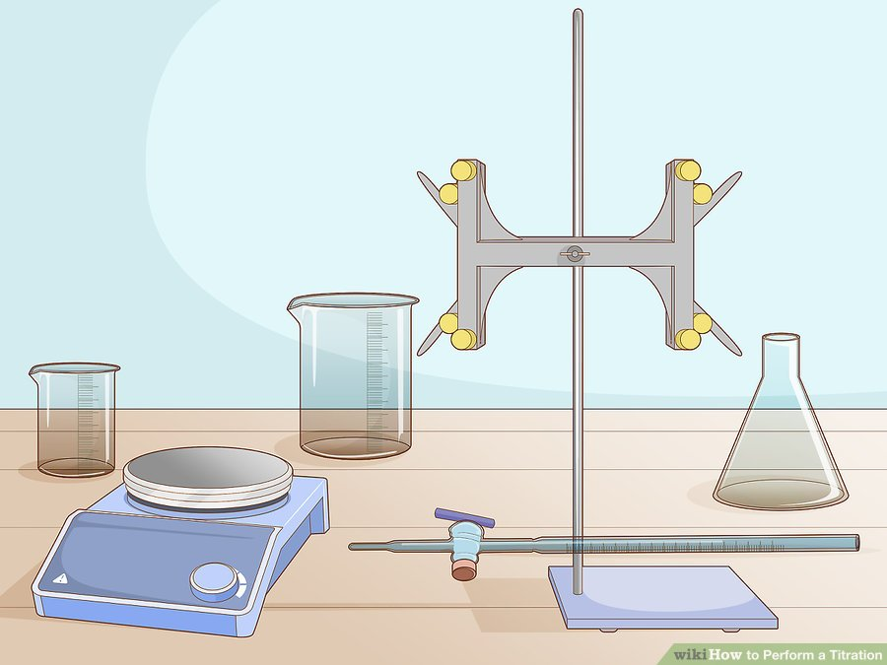
Steps Of the Experiment:
04
Setting up Your Equipment:
Step 01
Gather all the necessary equipment before starting because Performing a titration requires that you have all your equipment together before you start.

Slide 12
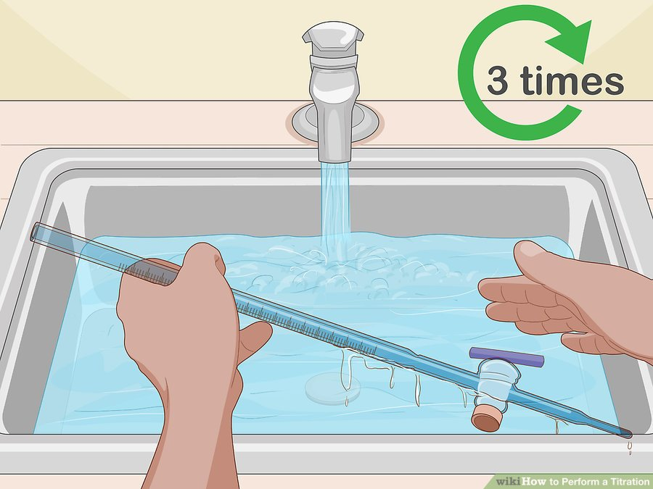
Steps Of the Experiment:
04
Setting up Your Equipment:
Step 02
Rinse and purge your burette. To get an accurate reading from your titration, your burette must be completely clean. Then, close the stopcock (the valve near the burette’s tip) and fill the burette with deionized water. Swirl the water around a few times before opening the stopcock and allowing it to drain.
Repeat the rinsing process at least 3 times with water to completely clean your burette.

Slide 13
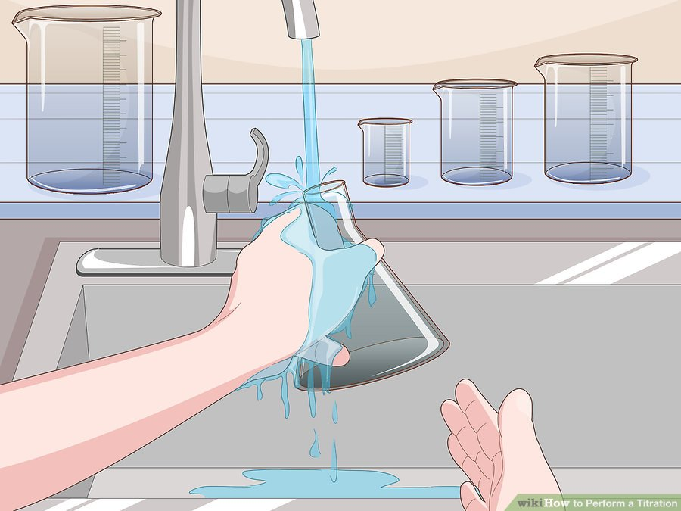
Steps Of the Experiment:
04
Setting up Your Equipment
Step 03
Repeat this Previous steps for cleaning with other tools.

Slide 14
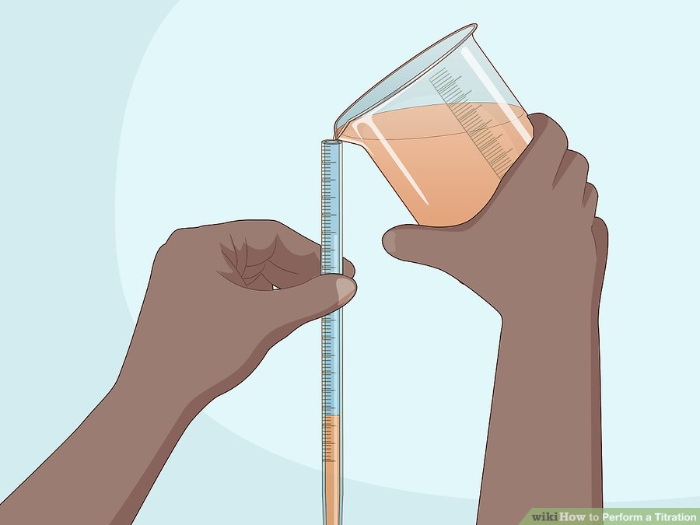
Steps Of the Experiment:
04
Setting up Your Equipment:
Step 04
Fill the burette with an excess amount of titrant. The titrant should be in a liquid form. Pour it in until you reach the zero point on the burette using a graduated cylinder or a small flask or beaker.
If you overfill your burette, open the stopcock slightly and let the excess titrant flow out until it reaches the zero mark.

Slide 15
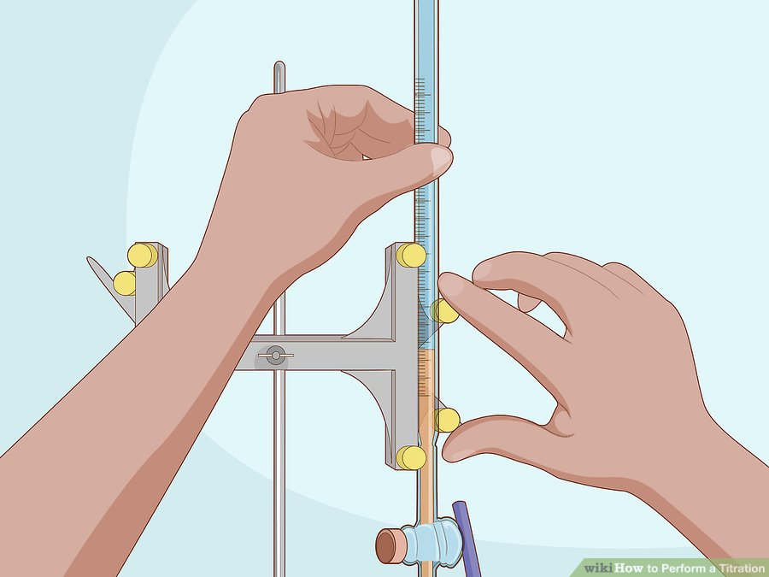
Steps Of the Experiment:
04
Setting up Your Equipment:
Step 05
Clamp the burette carefully to a burette stand. The burette should be secure enough so that it does not move or slide. Tighten the clamp slowly, though, to avoid cracking or breaking the burette. Make sure there is enough space between the tip of the burette and the bottom of the stand for your beaker or flask.

Slide 16
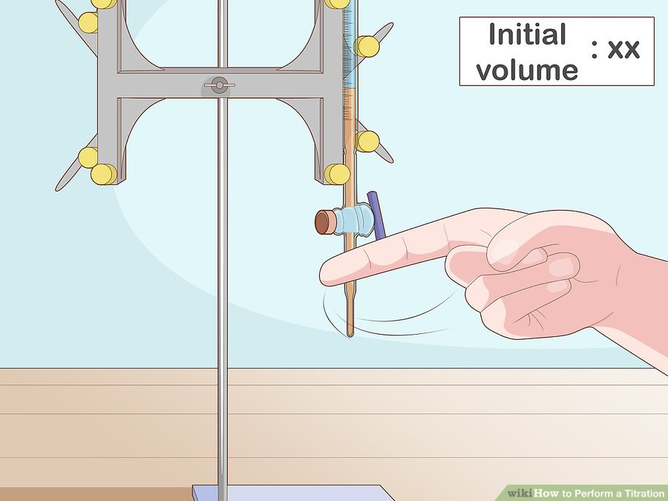
Steps Of the Experiment:
04
Setting up Your Equipment
Step 06
Tap the burette to remove any air bubbles. With the burette in the stand, carefully tap it with your index finger in order to remove any gas bubbles inside the liquid. Then record the initial volume of the burette at the meniscus (the lowest part of the dip in the liquid).

Slide 17
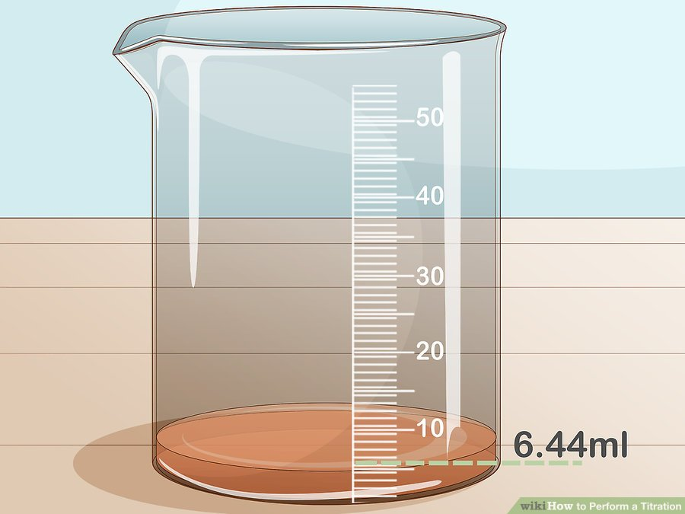
Steps Of the Experiment:
04
2. Conducting Your Titration:
Step 01
Measure out a precise amount of analyte in a clean beaker or flask. You need to know exactly how much of your analyte you’re using so that you can calculate your end concentrations. Use a pipette to measure out the necessary amount of analyte into your beaker.
If necessary, rinse the analyte into your beaker or flask, thus making sure all of the analyte is in the beaker.

Slide 18
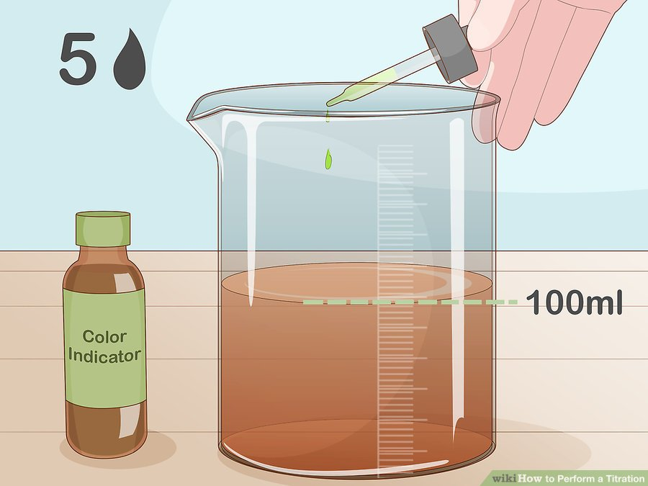
Steps Of the Experiment:
04
2. Conducting Your Titration:
Step 02
Drop a small amount of color indicator into the beaker. Many titrations require the addition of a color indicator prior to adding the titrant. The specific type of color indicator you need will depend on what titrant you are looking for.
Likewise, the amount of color indicator you need will depend on the volume of your analyte. Generally, you will need between 3-5 drops of indicator for 100 milliliters of analyte.

Slide 19
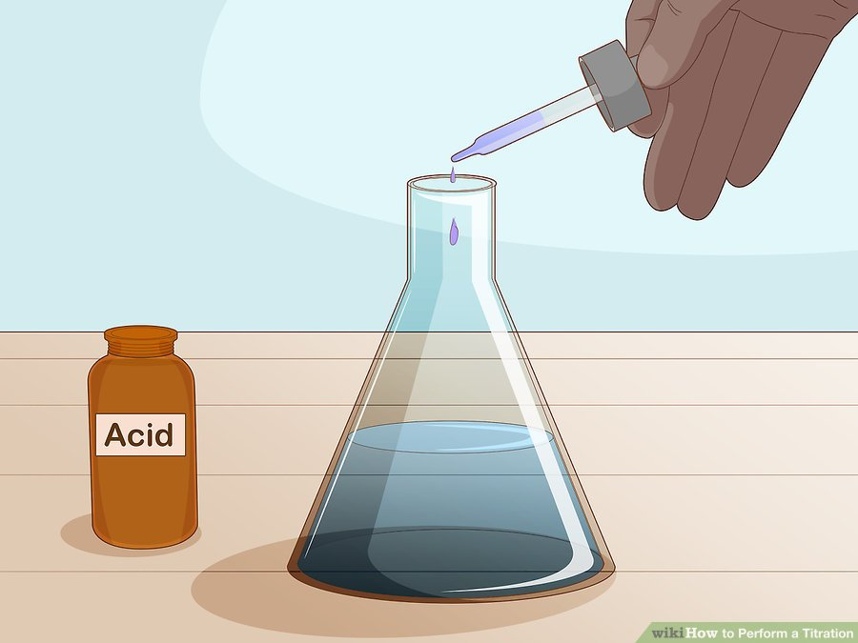
Steps Of the Experiment:
04
2. Conducting Your Titration:
Step 03
Add your second chemical, if necessary. While not all titration experiments require a second chemical, some do. This second chemical is sometimes referred to as a buffer. If your titration requires a buffer, use a pipette or measured dropper to add it to the analyte after you add the color indicator.
Generally, the buffer solution will be an acid or alkali in a specific, known concentration.

Slide 20
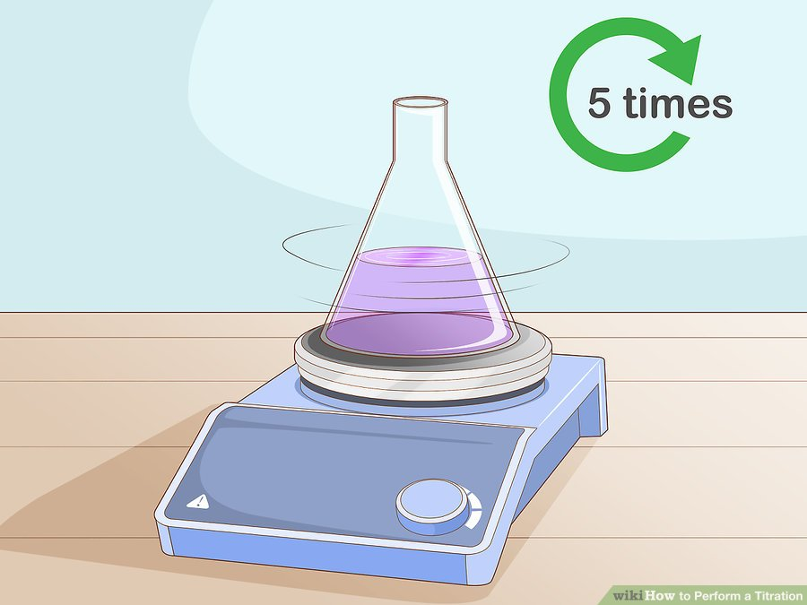
Steps Of the Experiment:
04
2. Conducting Your Titration:
Step 04
Agitate the beaker using a magnetic stir plate. If you have a magnetic stir plate available, place your beaker on it and drop the agitator into the beaker. Turn the plate on slowly until the agitator is swirling enough to mix the solution in the beaker without splashing it on the beaker walls.
You will leave the stir plate on until your titration is complete.
If you do not have a magnetic stir plate, you can agitate the beaker by hand by gently swirling it 4-5 times before placing it under the burette.

Slide 21
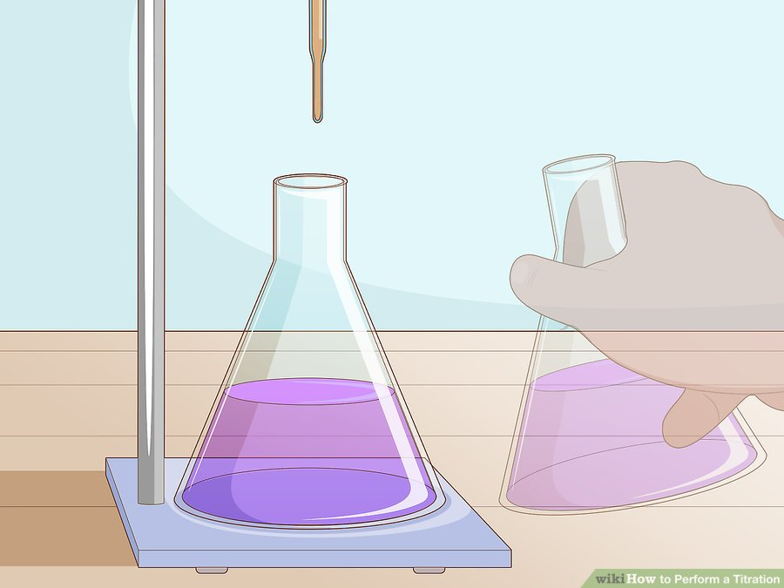
Steps Of the Experiment:
04
2. Conducting Your Titration:
Step 05
Place the beaker under the burette. The burette should be centered over the beaker. The tip should not be touching any of the beaker walls.

Slide 22
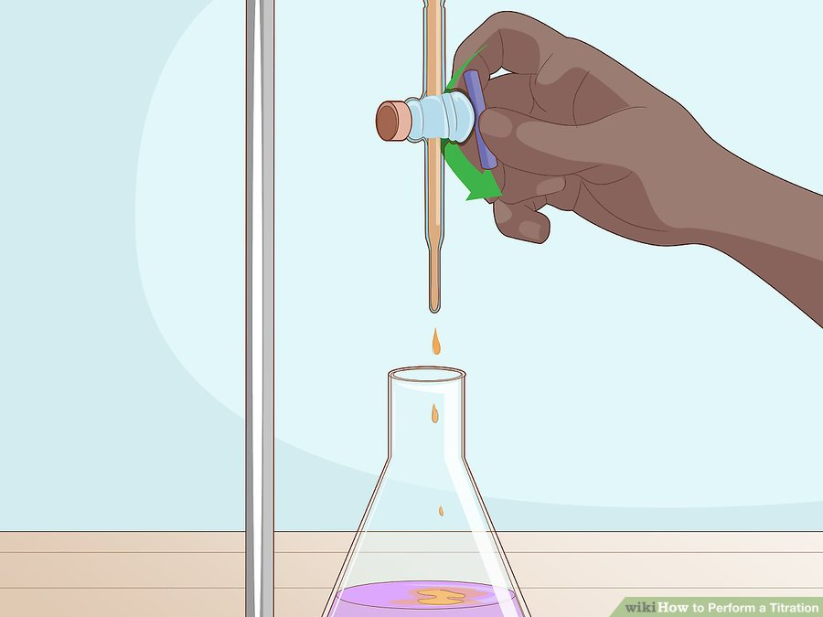
Steps Of the Experiment:
04
2. Conducting Your Titration:
Step 06
Slowly open the stopcock so that the titrant drips out of the burette. The titrant should come out of the burette drop by drop. Allow the titrant to drop into the analyte until you notice a color change in the beaker solution. The color change may be slight, so proceed slowly and watch carefully.
If you notice a color change, close the stopcock and allow the agitator to run for 30 seconds. If the color dissipates before the 30-second mark, open the stopcock slightly and continue to add the titrant drop by drop until you get a permanent change.

Slide 23
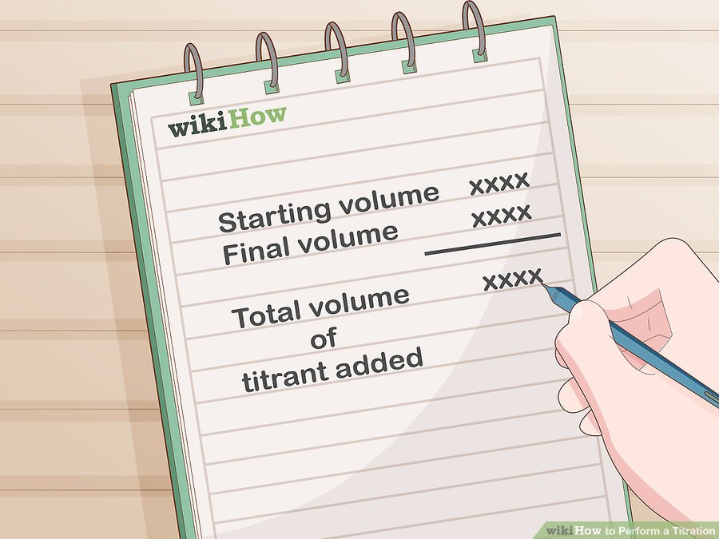
Steps Of the Experiment:
04
2. Conducting Your Titration:
Step 07
Record your final volume from your burette. Once you’ve reached the endpoint of your titration, close the stopcock and record the final volume of your titrant in the burette. Subtract your final volume from your starting volume to get total volume of titrant added.
When reading the end volume of your burette, make sure your eyes are at the level of the titrant meniscus. Take your reading from the meniscus.

Slide 24
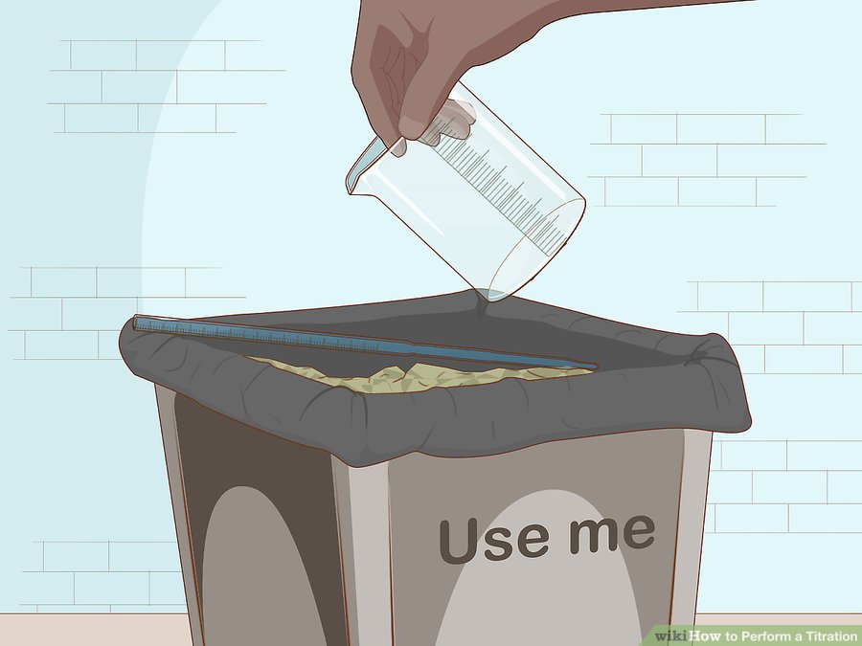
Steps Of the Experiment:
04
03. Finishing your analysis:
Step 01
Dispose of the chemicals used in a labeled waste container. Once you have completed your titration, empty out your beaker, your burette, and any other glassware you used into appropriate containers. If you are unsure of where these are, ask your instructor or lab director.

Slide 25
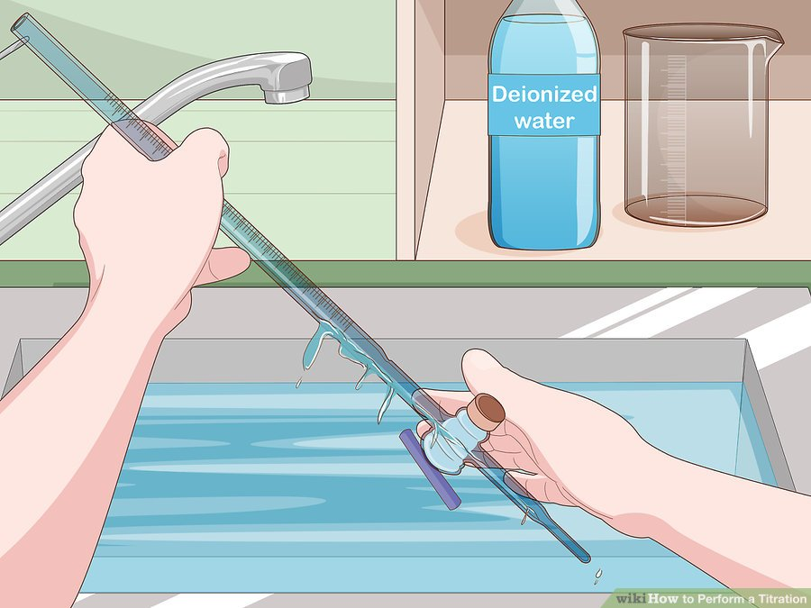
Steps Of the Experiment:
04
03. Finishing your analysis:
Step 02
Re-wash the tools used with deionized water. If deionized water is not available, tap water will work.

Slide 26
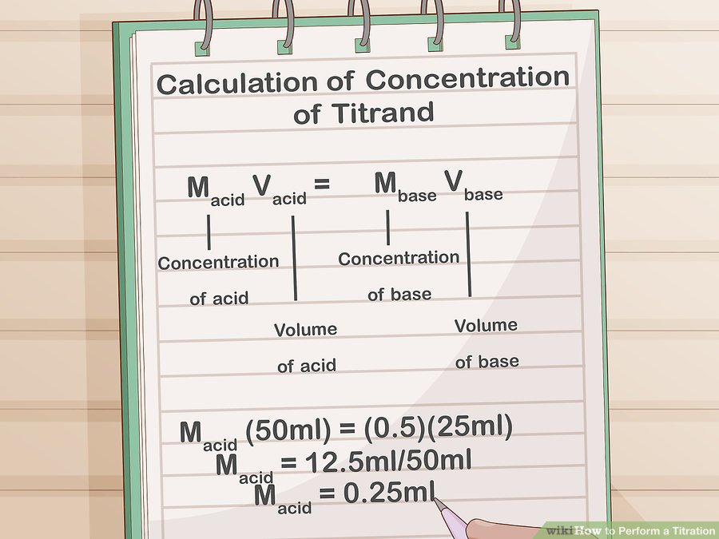
Steps Of the Experiment:
04
03. Finishing your analysis:
Step 03
Calculate the concentration of the titrand. Every type of titration will require a different calculation to determine the concentration of titrand in your analyte. Perform your titration calculations or check a titration curve for your specific titrand to quantify your results.
Calculations of the concentration should be done to the appropriate number of significant figures. Ask your instructor or lab director if you’re unsure of what these may be.

Slide 27
Steps Of the Experiment:
04
Chemical Titration Curve:
Demonstrates the point of equivalence

Slide 28
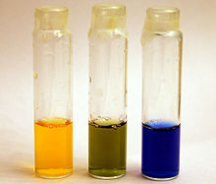
Observations :
Change the color of the solution solution to the parity point.
In the case if the solution which has unknown concentration an acid concentration, it will change its color from yellow to green.
In the case if the solution which has unknown concentration an base concentration, it will change its color from blue to green.

Slide 29
Conclusion:
At the equivalence point there will be an equal number of moles of the ions of the mixture in beaker (Acid) and the ions of the mixture in the calibrated burette (Base). This can easily be determined because the mixture will change color at the equivalence point by the addition of a single drop of base. At the equivalence point, or neutralization, the number of moles of acid equals the number of moles of base, if the mole ratio of the balanced equation is one.
The concentration of the unknown solution is calculated using relationships and equations, the most important of which are:
Quantity of reaction material = Quantity of material of the product

Slide 30
Video explains the experience of titration

