Slide 1
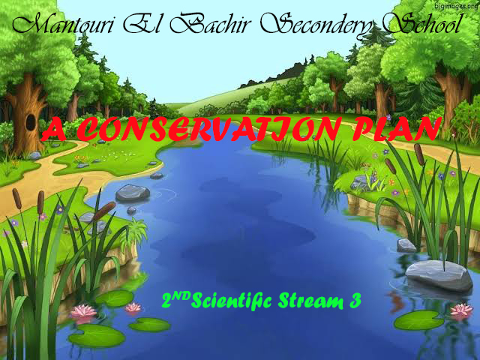
The People’s Democratic Republic of Algeria
Under the supervision of : Mrs. Maach
Members:
Haloui Dhoha * Lemzerri Sara *Mekadam Safa * * Djwanbi Ilya * Torchi Souhir

Slide 2
Introduction:
In the beginning, after peace and greeting, I present to you briefly a simple introduction about our project that we would like to discuss today, which is entitled “A Conservation Plan” , and we hope that we will be successful in presenting all the elements and ideas that the project deals with, and it will be specialized and comprehensive for all the details that everyone is searching for. We put in your hands this project, which we hope will be on the level, hoping for the honorable professors, as well as our fellow students, that you should not skimp on us with your comments and suggestions.

Slide 3
The project consists of :
Conservation Fact Sheet
The country code of 2019
Our ideal town
A diagrams with pesentations about the process of Recycling
Fires

Slide 4

Conservation Fact Sheet
Natural resources
Natural resources are components that exist in the world without the input of humans. These natural resources are diverse ranging from renewable resources to non-renewable resources, living to non-living resources, tangible to intangible resources. Natural resources are essential to the survival of humans and all other living organisms.

Slide 5

Algeria is more advanced in nature conservation than its neighbours Morocco Tunisia, with a comprehensive environmental law that includes nature conservation : soil , water , wild life and open spaces , mineral resources and monuments .

Slide 6
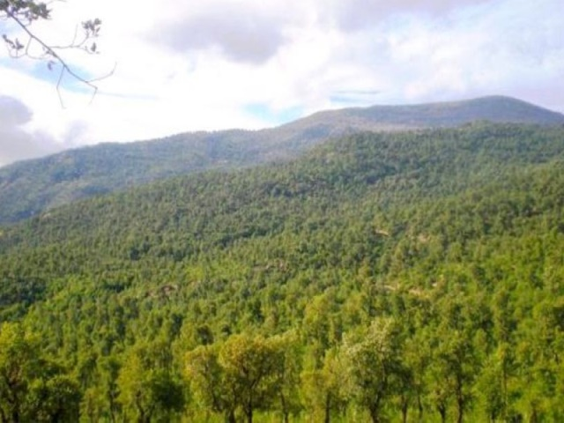
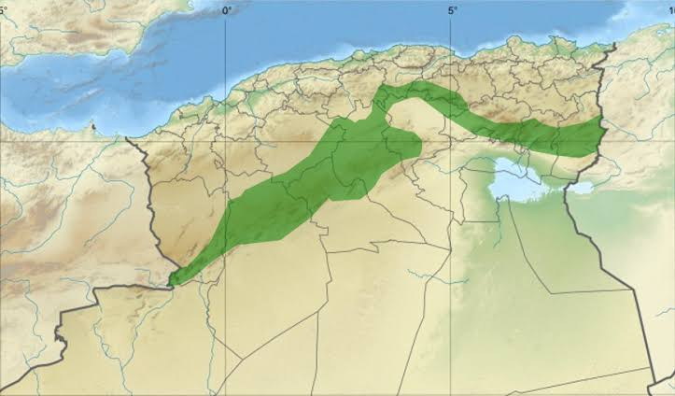
a- Soil :
The Green Dam is a project that was launched in Algeria in 1971 in order to reduce the advance of desertification and its progress towards the fertile part in the north of the country.

Slide 7
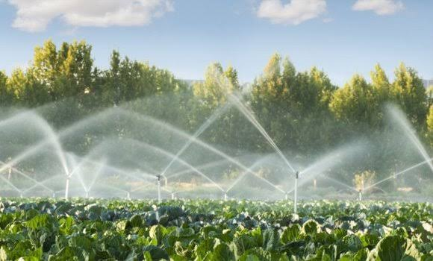
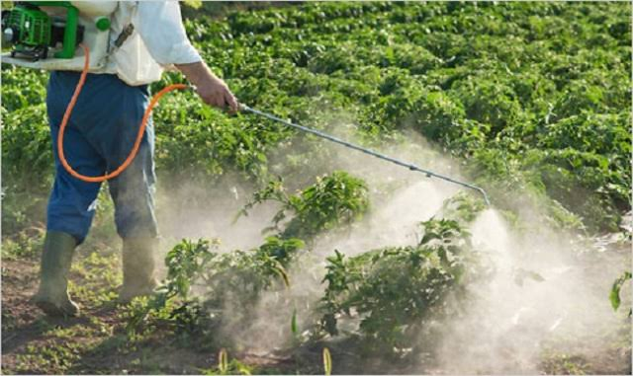
The use of modern irrigation technology is encouraged in order to preserve water resources throughout Algeria.
-Southern sand dune is fixed (Biskra-Hassi Massoud...)
500 km of farmland is retabilitated in the north.
The farmers are educated about the right way to use the pesticides and fertilizers in the agricultural field by the Algerian government.

Slide 8
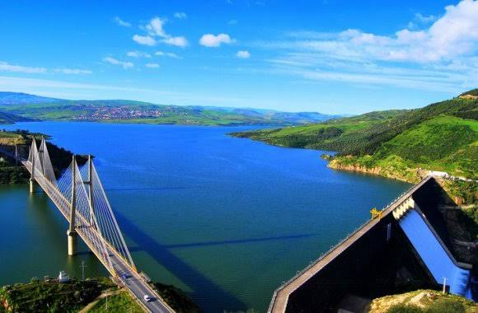
B- water
Construction of dams to recharge groundwater, like :Bani Haroun Dam which is the bigest in africa ; and water monitoring systems and rain in the north (algiers,Telemcen,Oran...) also in the south for e.g.;Ghardaïa
Stimulating economic and financial waste-water treatment

Slide 9
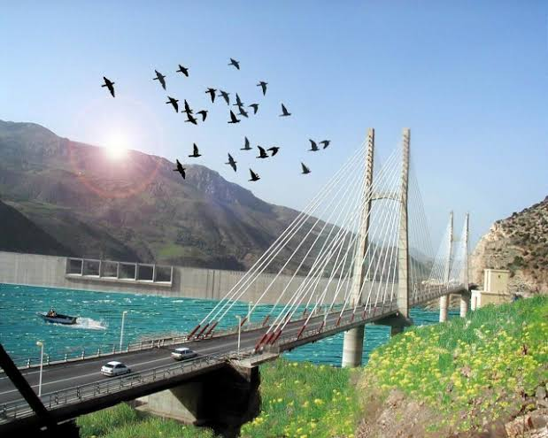

Slide 10
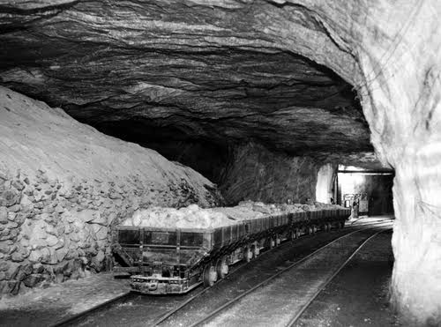
C - mineral resources :
The using of the mineral resources will be reduced if :
-The people who mines and digs for minerals will be stopped .
- Plastics will be used in the place of minerals like aluminium..
-This mineral resources will be changed by another energy like the solar energy or by the energy of winds...

Slide 11
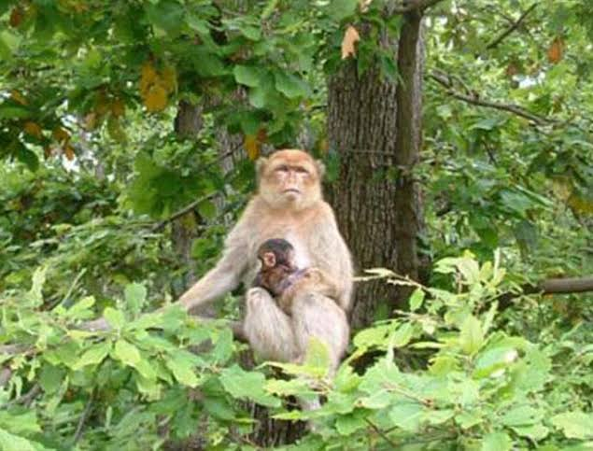
D- Wild life and open spaces :
System of protected reserves and parks :
Biosphere reserves are areas including terrestrial, marine and ' coastal ecosystems.
Each reserve gives solutions for the conservation of biodiversity and prevention of conflicts or problems between man, animals and plants.
Biosphere reserves are special places for scientists and researchers to understand changes and interactions between man and ecological systems
.as Algerians national parks have a rich variety of ecosystems, we have ad eight of them into Biosphere Reserves.

Slide 12
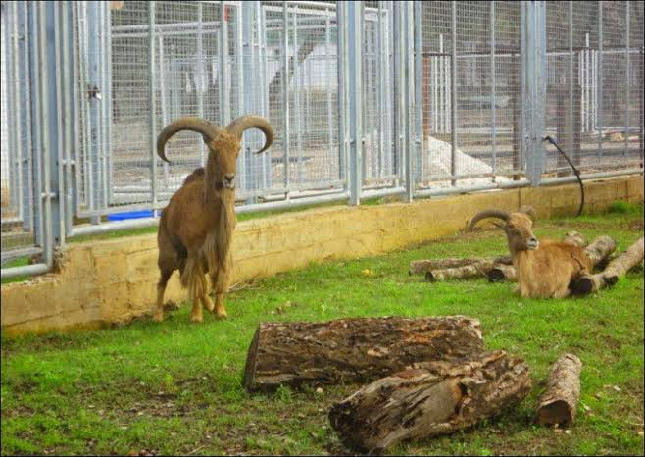
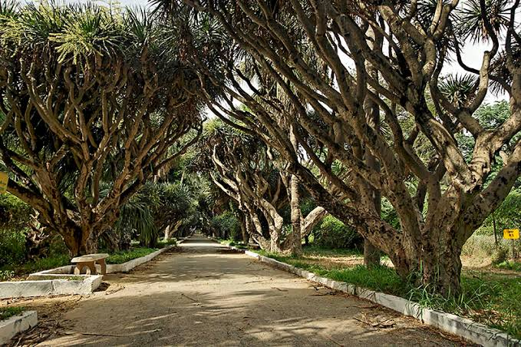
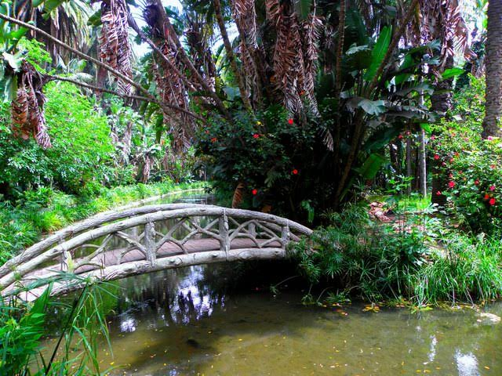
Tassili n’Ajjer was the first Algerian park to be in 1986 as a Biosphere Reserve. Then comes El Kadesignated la, followed by Djurdjura, Chrea, Taza, Gouraya, Belezma and, fmally, Tlemcen Mountains -the last Algerian Biosphere Reserve to be designated in 2016.

Slide 13
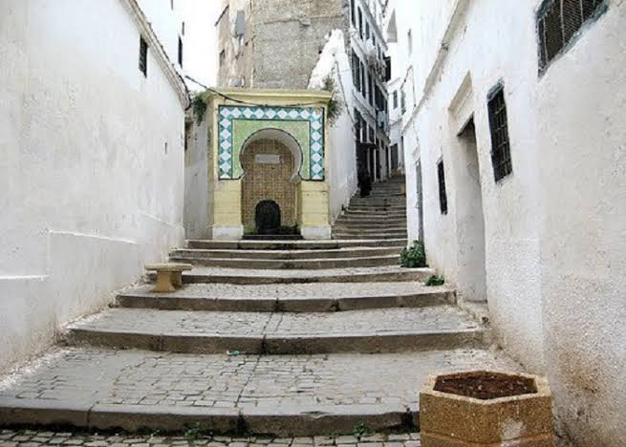
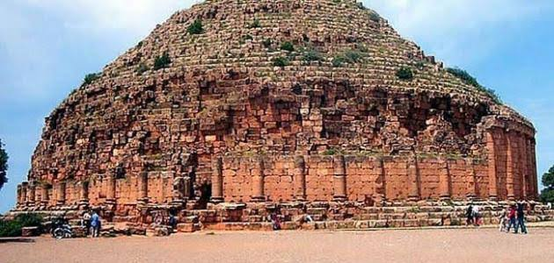
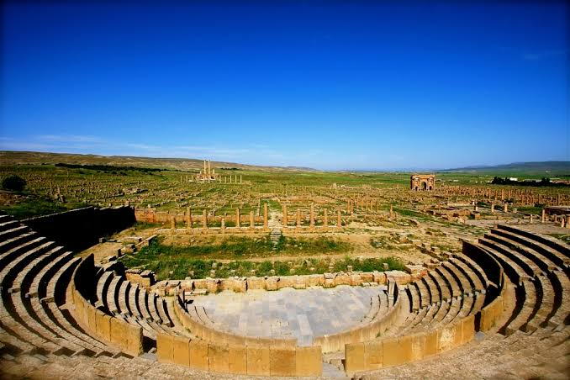
E- Monuments :
The General Command of the Algerian National Gendarmerie Program, the information provided to protect monuments and historical heritage in Algeria
National day of historical heritage
Roman ruins protected in Temgad
Re-create old cities like the Kasbah

Slide 14
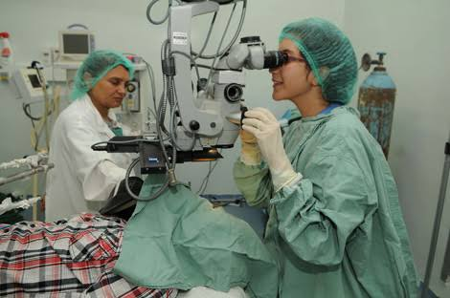
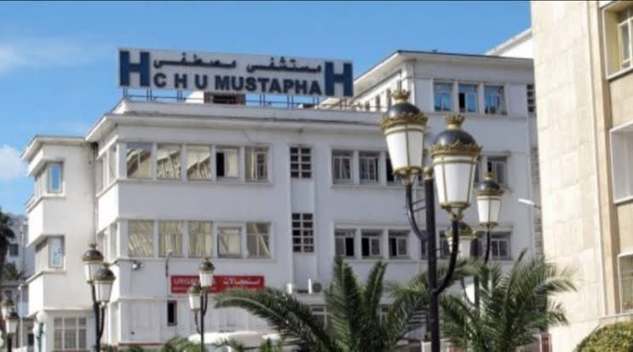

Human resources
A- Health
Improving health services, especially in remote areas.
250 projects to build a hospital in remote and desert areas
Rehabilitation and medical and social support for persons with disabilities, the government increased the number of care institutions.
Providing necessary equipment and medical staff
Free treatment

Slide 15
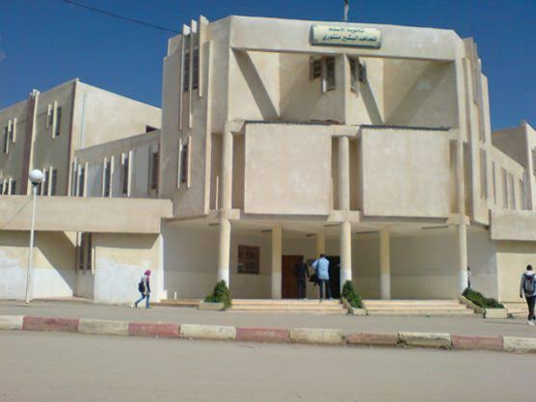
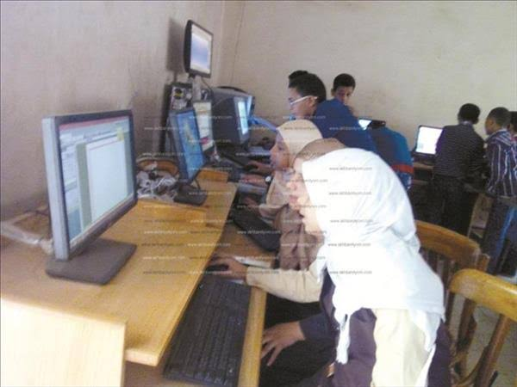
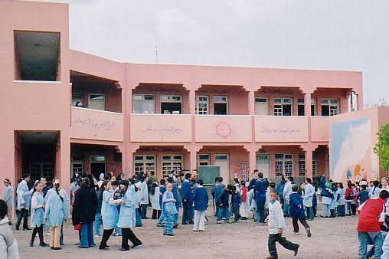
B- Education
-Building schools especially in remote regions.
-All the schools will be providing with computers.
-Building private schools to wipe out illiteracy, especially in areas remote and deserts.
-The education of the rural women.

Slide 16
C-culture
At the present time, Algerian culture has become more developed and open. Young people in Algeria prefer to use the Internet, and the percentage of reading and reading newspapers is still medium, especially among women, and they usually prefer Western, action and romantic films
Algerian literature Many famous writers originated in Algeria, who have a major role in the literary renaissance, and they also won the Nobel Prizes, such as writer Henry Qarba of Algeria, and writer Asia Jabbar, and the most famous Algerian writers are also Ahlam Mostaghanemi, Tahar Fadila Al Farouq, and Moufdi Zakaria

Slide 17
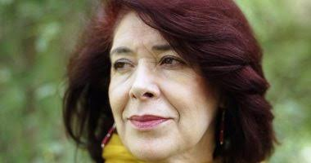


Slide 18
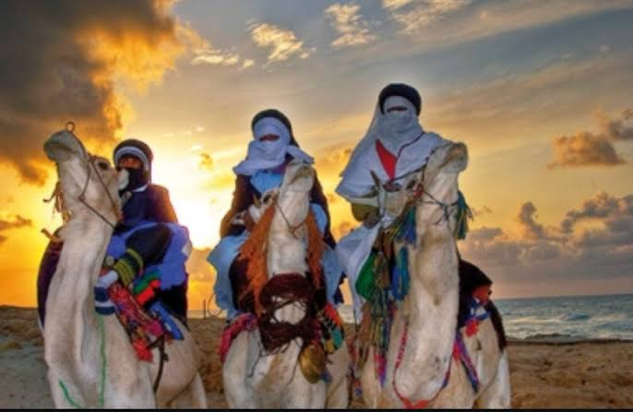
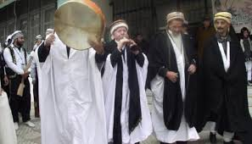
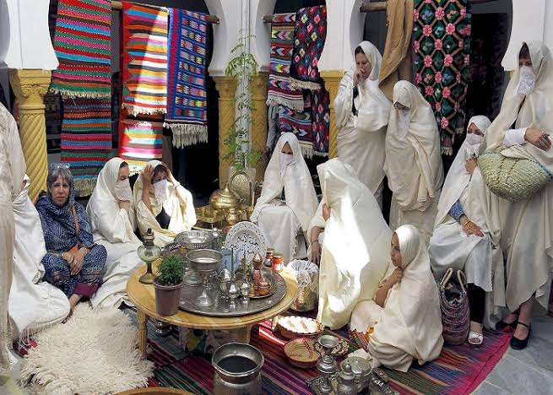
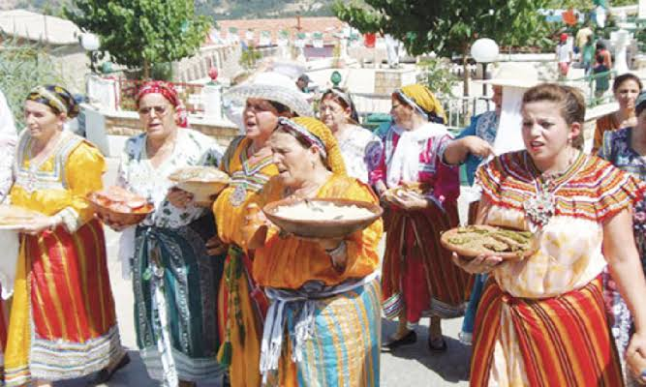
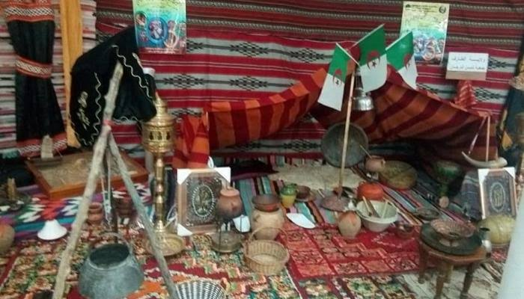
And the Algerian culture varies between east, west, north and south
It is a country rich in customs and traditions, and you have a region of its own heritage
For example
There are kabils in the north
Chaouia in the center and Touareg in the south

Slide 19
D – Economy
Competent Ministry of Trade and Supply and means to take actions and measures and decisions necessary to protect the national economy from the damage caused by the dumping or subsidies or unjustified increase in imports, as defined in the scope of the agreements contained in the Final Document of the outcome of the Uruguay Round of multilateral trade negotiations that was approved by the Republic of Egypt president's decision No. 72 of 1995
.Stimulating economic and financial waste-water treatment

Slide 20


Slide 21
The UN Environment Programme (UNEP) annually organizes events for World Environment Day, which encourages worldwide awareness and action for the protection of the environment. It is celebrated on 5 June in over 100 countries.
The 2020 edition of World Environment Day is expected to provide an opportunity for driving the momentum and public awareness of nature as a key aspect in the lead up to the 15th meeting of the Parties (COP 15) to the Convention on Biological Diversity (CBD) in Kunming, China, in 2020.

Slide 22


Slide 23
World Environment Day 2019
Air pollution
Did you know that only 12 per cent of cities have air quality measures that meet WHO standards?
That 4.3 million deaths are attributed to indoor air pollution from cooking?
Or that 90 out of 193 countries do not have vehicle emission standards?
World Environment Day is the United Nations day for encouraging worldwide awareness and action to protect our environment. Since it began in 1974, the event has grown to become a global platform for public outreach that is widely celebrated in over 100 countries.

Slide 24
Each World Environment Day is organized around a theme that draws attention to a particularly pressing environmental concern. The theme for 2019 is “Air pollution”.
Every World Environment Day has a different host country, where the official celebrations take place. The focus on the host country helps highlight the environmental challenges it faces and supports worldwide efforts to address them. This year's host is China.
In recent years, millions of people have taken part in thousands of registered activities worldwide. Please sign up on the global website so we can keep you updated on what’s happening.
Find an event near you and get involved to fight Air Pollution

Slide 25


Slide 26
Our ideal town
Who among us does not want to live in an ideal pollution-free environment with great weather and a luxurious life
we can ideas develpment what might put us in an ideal setting
That people in the healthy city have access to profitable jobs
stable and sufficient income
good health facilities and services
a supply of safe water, sanitation facilities, that waste is collected and disposed of in a proper way, that the streets are clean and paved

Slide 27
that the environment is free from pollution and overcrowding,
that roads and transportation are safe and adequate,
that they have good communications systems,
and that there are spacious public parks, green spaces, sports fields and recreational facilities
And last but not least, the city must have its distinct personality, and its environment must be vibran

Slide 28
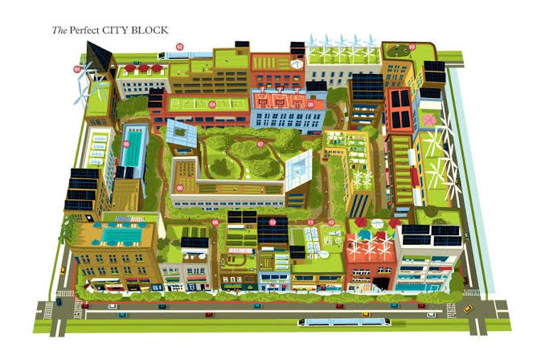

Slide 29
As a new generation, we propose to you this blueprint of our ideal city, which we hope will materialize on the ground
- Urban development plans should be developed
Create green spaces
Providing amusement facilities for children
Put recycling bins
Construction of power plants using wind energy
The buildings are provided with systems to maintain the temperature to avoid energy loss
Replacing regular lighting poles with columns equipped with a solar cell
Placement of a factory filter
Reducing the use of coal energy
By taking these measures, we will obtain a city without pollution

Slide 30
A diagram about the process of Recycling swages
The process of recycling water means that the water used for any purpose is to be brought in, revised and qualified again. The process of recycling water is considered one of the most important biological processes as we mentioned, because it is simply related to the most important thing concerning humans on this earth, and the fact that the idea of ​​recycling used water was not raised at all recently, and specifically before the world wars that flared up in the last century, but After the wars ended, humans began to think about life and ways to preserve it again

Slide 31
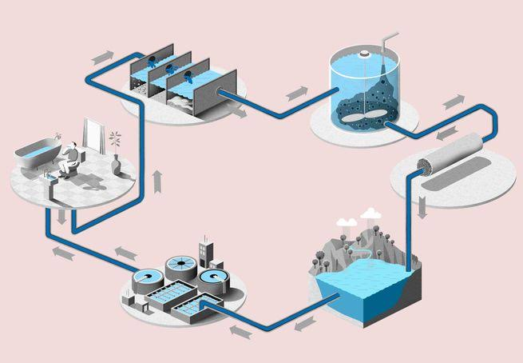
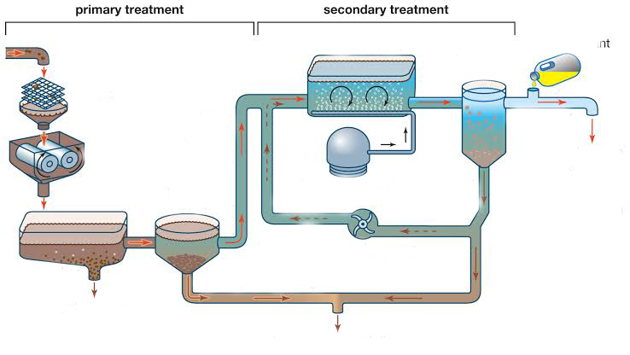

Slide 32
First, swages are thrown into the homes and collected in sewage channels
Second, the wastewater is transferred to the treatment station by pipes
In treatment station, water is recycled through Three stages :
1 -Physical treatment :
The first steps in the water recycling process are to treat the pollutants in it, such as stones, solid materials and other physical materials. This task occurs in several ways, including sifting and sedimentation, and using insulating materials so that at the end of this stage we will get water without physical contaminants.

Slide 33
2- Biological treatment:
In the second stage of water recycling, which is called biological treatment, the water under the circulation process is exposed to air, to get rid of the organic matter materials, which are deposited in the water, and the fact that exposing the water and air causes the bacteria that get rid of the organic materials Mentioned above, and there is another method that is used in biological treatment, and it is the method of deposition, in which it deposits microbes that are permeated with water
3 - Chemical treatment :
In the last stage of water recycling, chemicals are entered into the water, such as hydrogen chlorine, to purify the water, sterilize it, and make it suitable for use.
Finally, water is poured into the dams, where is it redistributed and used in daily activities and agriculture ...

Slide 34
In conjunction with the massive fires that broke out in Australia and the losses and impacts that were left behind, which are related to our topic, we wanted to summarize for you some of the causes of fires and methods of prevention
Fires in the world
Not a day goes by but you hear about a massive fire or several fires in different regions in the world. The fire may be in a factory or a house and may lead to injuries or deaths among citizens, as well as the tremendous losses that result from the occurrence of the fire.
Preventing fire :
To prevent fire, its causes must be removed: such as limiting the phenomenon of pollution and preventing smoking in prohibited places, adopting means against electrical sparks, the use of electrical cutters

Slide 35
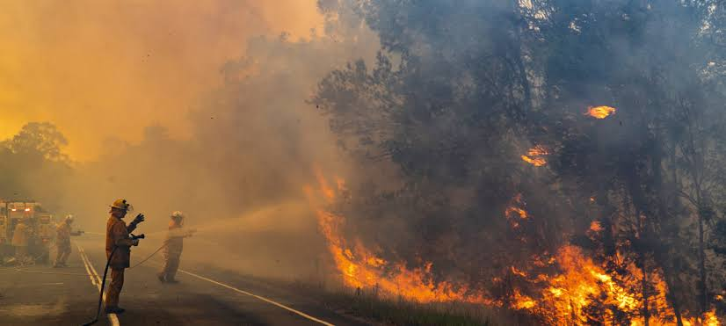
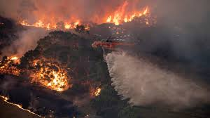
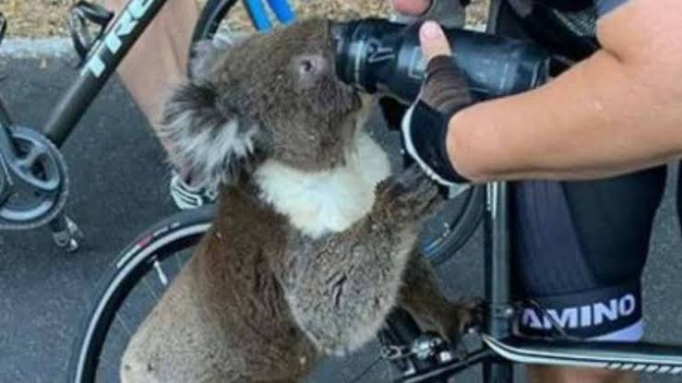

Slide 36
Leave the waste and flammable waste in the self-ignited manufacturing area in the presence of heat.
oversight: forget about the gas stove and what is on it.
Bad and dangerous storage of flammable or explosive materials.
The occurrence of sparks or an unusual rise in temperature due to friction in the mechanical parts.
Indifference and negligence: such as throwing a burning matchstick or following a cigarette on a flammable object.
The presence of liquid waste and flammable oils in the workplace.
Global Warming
There are also other reasons that the person has no hand in, such as thunderbolts, earthquakes, and high air temperature.
Preventing fire :
To prevent fire, its causes must be removed: such as limiting the phenomenon of pollution and preventing smoking in prohibited places, adopting means against electrical sparks, the use of electrical cutters, and

Slide 37
Conclusion
At the end of the topic and from the above it becomes clear to us the importance of this topic, for this it was necessary to direct him all efforts, care and attention, and one of the lessons learned that we come out of this matter is that nature must be protected and environmental diversity preserved and every effort should be made to reduce pollution.
And because the topic is important, we hope that all those interested in scientific research on this topic will benefit in their scientific research
By this we have finished writing this research, and pray to God for success for me and you, God Almighty, and may God’s peace, mercy, and blessings be upon you.

